Slide 1
Consciousness is…
alertness; being awake vs. being unconscious
self-awareness; the ability to think about self
having free will; being able to make a “conscious” decision
a person’s mental content, thoughts, and imaginings
To explore the nature of consciousness, it helps to first choose a definition.
“our awareness of ourselves and our environment.”
Aren’t animals aware of their environment?
If so, is our awareness different?...
Possibly…because we have (uniquely?) a narrative experience of that awareness.
Notes:
Click to reveal bullets and definition
Instructor: Other comments for the class or for the slide, clarifying the word “awareness” in the definition:
“seeing one’s foot (and sniffing it) may be a dog’s level of awareness.”
Humans uniquely may have a narrative experience of that awareness, with identity as part of the narrative. We can react to a noise AND tell a mental story about how we reacted, even if a strict behaviorist might see that story as irrelevant. We see the foot at the end of the bed as part of ourselves; if we had a tail, we would not chase it. People can look in a mirror and see not just a set of features but a face, a self.
This chapter is concerned with:
the quality our mental experience.
the role of the brain in that experience.
the way that experience is affected by the two tracks of mental experience.
the way that experience is altered by
sleep.
hypnosis.
psychoactive drugs.
Psychology was once defined as “the description and explanation of states of consciousness.” Now, consciousness is just one topic among many for psychologists. Cognitive neuroscience allows us to revisit this topic and see how the brain is involved.

Slide 2
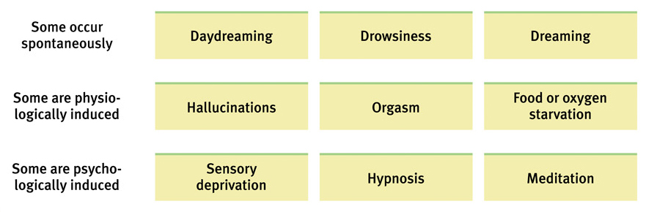
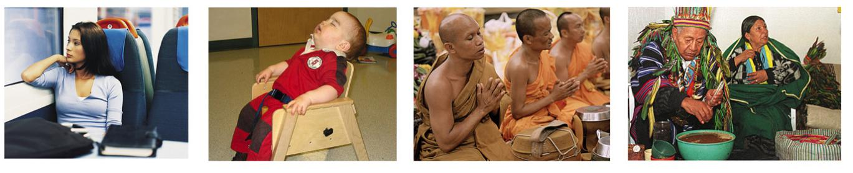
Forms of Consciousness
Notes:
No animation.
Instructor: Students can be asked, “Where in this table would you put marijuana use? Or ‘blanking out’ during trauma?”

Slide 3
What is unconsciousness?
The unconscious is where most of the work of the mind gets done; it's the repository of automatic skills (such as riding a bike), the source of intuition and dreams, the engine of much information processing. Fleeting perceptions register in the unconscious mind long before we may be aware of them.

Slide 4
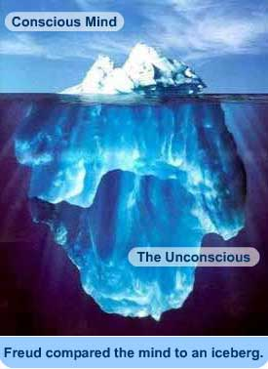

Slide 5
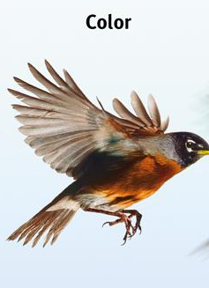
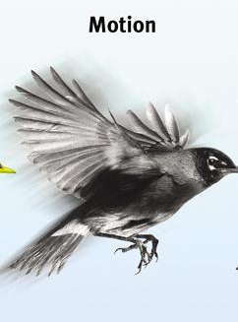
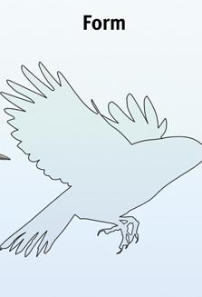
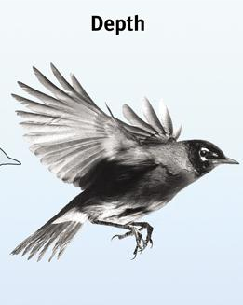
Conscious vs. Unconscious Activity: The Dual-Track Mind
Conscious “high” track:
our minds take deliberate actions we know we are doing
Examples: problem solving, naming an object, defining a word
Unconscious “low” track:
our minds perform automatic actions, often without being aware of them
Examples: walking, acquiring phobias, processing sensory details into perceptions and memories
Automatic processing: Conscious “high” track says, “I saw a bird!”
Unconsciously, we see:
Notes:
Automatic animation for high track and low track. Click to show start of example. Click again to show the rest of the example.

Slide 6

Why Have Two Tracks?
Possible benefit: not having to think about everything we do all at once
Examples
You can hit or catch a ball without having to consciously calculate its trajectory.
You can speak without having to think about the definitions of each word.
You can walk and chew gum AND carry on a conversation.
Notes:
Click to reveal bullets and then sidebar with bullets.
Third bullet: this is similar to Wilhelm Wundt’s experiment in the late 1800s, in which participants were quicker to push a button about seeing the ball fall than they were about being aware of hearing the ball fall. The delay is not for the same reason…hopefully this generates a good discussion, maybe even about whether free will is an illusion. However, the facts bring us back to the two-track topic; that conscious awareness of an action is not as fast a process as simply taking the action.

Slide 7

Unusual Consequences of Having a Dual-Track Mind
Blindsight
Selective
Attention
Selective Inattention
Inattentional blindness
Change blindness
Choice blindness
Notes:
Click through to reveal all text boxes.

Slide 8
Selective Attention: what we focus on, what we notice
Selective Inattention:
what we are not focused on, what we do not notice
Selective inattention refers to our failure to notice part of our environment when our attention is directed elsewhere.
Selective Inattention:
inattentional blindness
change blindness
choice blindness
Notes:
Click to reveal text boxes.

Slide 9
Sleep as a State of Consciousness
How Do We Learn About Sleep and Dreams?
We can monitor EEG/brain waves and muscle movements during sleep.
We can expose the sleeping person to noise and words, and then examine the effects on the brain (waves) and mind (memory).
We can wake people and see which mental state (e.g. dreaming) goes with which brain/body state.
When sleeping, are we fully unconscious and “dead to the world”?
Or is the window to consciousness open?
Consider that:
we move around, but how do we stop ourselves from falling out of bed?
we sometimes incorporate real-world noises into our dreams.
some noises (our own baby’s cry) wake us more easily than others.
Notes:
Click to reveal all text and bullets.
Instructor: In the sidebar, the third strategy is the way in which the brain waves and eye movements of REM sleep were discovered to be associated with dreaming.

Slide 10

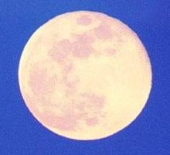
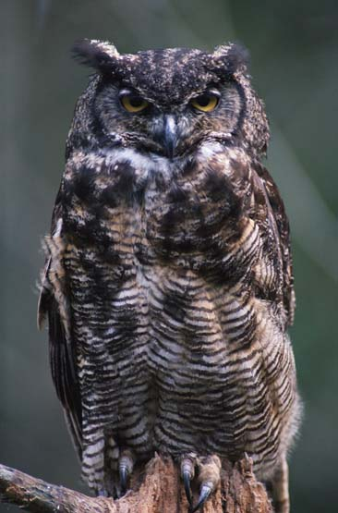
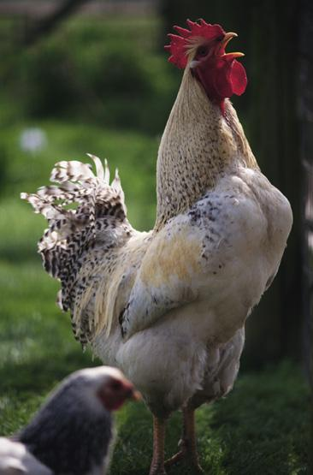
Daily Rhythms and Sleep
The circadian (“about a day”) rhythm refers to the body’s natural 24-hour cycle, roughly matched to the day/night cycle of light and dark.
“Larks” and “Owls”
Daily rhythms vary from person to person and with age.
General peaks in alertness:
evening peak—20-year old “owls”
morning peak—50-year old “larks”
What changes during the 24 hours?
Over the 24 hour cycle, the following factors vary, rising and falling over the course of the day and night:
body temperature
arousal/energy
mental sharpness
Notes:
Click to reveal all text.
Instructor: Light affects this rhythm through a process involving the brain; more about this later when we talk about WHY we sleep.

Slide 11

Why do we sleep?
We spend one-third of our lives sleeping.
If an individual remains awake for several days, immune function and concentration deteriorates and the risk of accidents increases.
Jose Luis Pelaez, Inc./ Corbis
Notes:
Preview Question 3: How does sleep loss affect us?

Slide 12
Sleep Theories
Sleep Protects: Sleeping in the darkness when predators loomed about kept our ancestors out of harm’s way.
Sleep Helps us Recover: Sleep helps restore and repair brain tissue.
Sleep Helps us Remember: Sleep restores and rebuilds our fading memories.
Sleep may play a role in the growth process: During sleep, the pituitary gland releases growth hormone. Older people release less of this hormone and sleep less.
Notes:
Preview Question 4: What is sleep’s function?

Slide 13
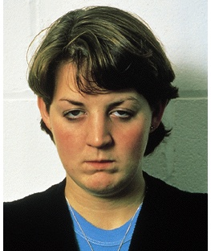
Sleep Deprivation
Fatigue and subsequent death.
Impaired concentration.
Emotional irritability.
Depressed immune system.
Greater vulnerability.

Slide 14
Sleep Disorders
Children are most prone to:
Night terrors: The sudden arousal from sleep with intense fear accompanied by physiological reactions (e.g., rapid heart rate, perspiration) which occur during Stage 4 sleep.
Sleepwalking: A Stage 4 disorder which is usually harmless and unrecalled the next day.
Sleeptalking: A condition that runs in families, like sleepwalking.

Slide 15

Altering Consciousness
Drugs
Psychoactive drugs are chemicals introduced into the body which alter perceptions, mood, and other elements of conscious experience.
Dependence/Addiction
Many psychoactive drugs can be harmful to the body.
Psychoactive drugs are particularly dangerous when a person develops an addiction or becomes dependent on the substance.
Factors related to addiction:
tolerance
withdrawal
impact on daily life of substance use
physical and psychological dependence
Notes:
Click to reveal sidebar and bullets.

Slide 16
Dependence
In physical dependence,
the body has been altered in ways that create cravings for the drug (e.g. to end withdrawal symptoms).
In psychological dependence,
a person’s resources for coping with daily life wither as a drug becomes “needed” to relax, socialize, or sleep.
Notes:
Automatic animation.

Slide 17
Dependence on a substance (or activity?)
Tolerance: the need to use more to receive the desired effect
Withdrawal: Upon stopping use of a drug (after addiction), users may experience the undesirable effects of withdrawal.
Using more than intended
Persistent, failed attempts to regulate use
Much time spent preoccupied with the substance, obtaining it, and recovering
Important activities reduced because of use
Continued use despite aversive consequences
Notes:
Click to reveal bullets.
Tolerance of a drug refers to the diminished psychoactive effects after repeated use.
Tolerance feeds addiction because users take increasing amounts of a drug to get the desired effect.
Regarding criteria #4 (“Persistent, failed attempts to regulate use): Why is it a sign of dependence when you want or try to cut back? Aren’t addicts in denial and not bothering to try to quit? This may be true in conversations with family, but internally, here’s one way of looking at what’s going on: it's a sign of dependence when you DO try to quit, and fail. If there is "little effort," you don't find out how hard it is to quit, or there may be little effort to quit because there is little need to quit.

Slide 18
Misconceptions About Addiction
Addiction is a craving for a chemical substance, despite its adverse consequences (physical & psychological).
Addictive drugs quickly corrupt.
Addiction cannot be overcome voluntarily.
Addiction is no different than repetitive pleasure-seeking behaviors.

Slide 19
Psychoactive Drugs
Psychoactive drugs are divided into three groups.
Depressants
Stimulants
Hallucinogens

Slide 20
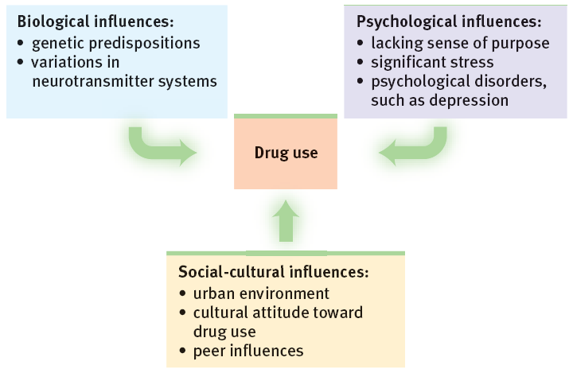
What influences can lead to drug use?
Notes:
No animation.

Slide 21
What can turn drug use into dependence?
Biological factors: dependence in relatives, thrill-seeking in childhood, genes related to alcohol sensitivity and dependence, and easily disrupted dopamine reward system
Psychological factors: seeking gratification, depression, problems forming identity, problems assessing risks and costs
Social influences: media glorification, observing peers
Notes:
Click to reveal bullets.

Slide 22
Influence for Drug Prevention and Treatment
Education about the long-term costs
Efforts to boost people’s self-esteem and purpose
Attempts to modify peer associations and teaching refusal skills

